Slide 1
JOB MARKET ANALYSIS
PTID-CDA-JUL-23-022-PRDA-04

Slide 2
Contents-
Get data from the database with the given credentials.
Queries
States with Most Number of Jobs.
Average Minimal and Maximal Salaries in Different States.
Average Salary in Different States.
Top 5 Industries with Maximum Number of Data Science Related Job Postings.
Companies with Maximum Number of Job Openings.
Job Titles with Most Number of Jobs.
Salary of Job Titles with Most Number of Jobs.
Skills Required by Companies for Each Job Title.
Relation between Average Salary and Education.
Analyse all the features and derive multiple insights.
Visualize the data using Tableau /Power BI and derive insights and give your inputs/suggestions to the
company.

Slide 3
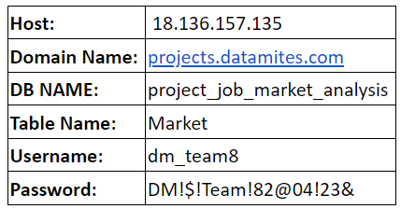
About Dataset:
Your aim of this project is to analyze the job market trends for positions by analyzing job data which includes 742 rows and 42 features like Job title, Salary Estimate, Job Description, Rating, Company, Location, Company, Headquarters and many more acquired from various sources. Your goal is to identify the most in-demand skills, qualifications, job responsibilities and provide insights that can inform job seekers and employers.
I followed those steps
Data Extraction
Data Mining
Data cleaning
Data Exploration
Data visualisation
About data credentials:

Slide 4
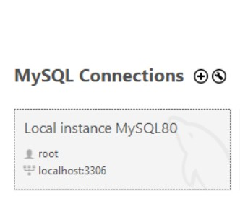
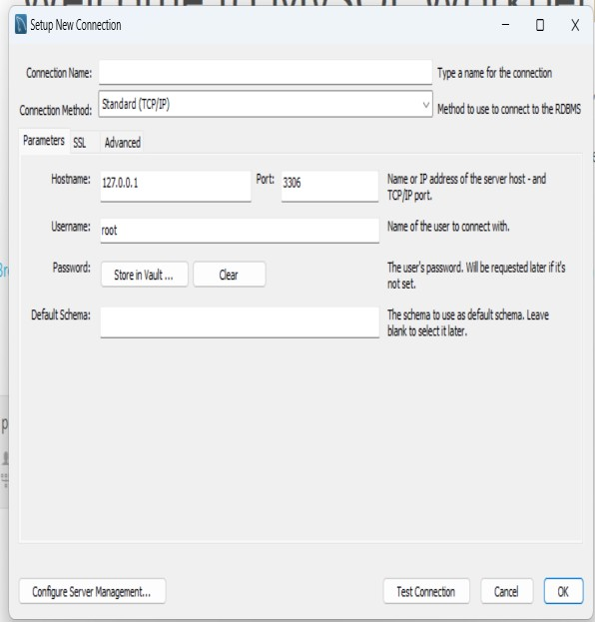
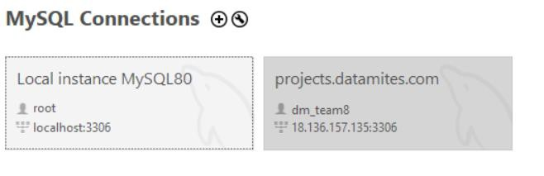
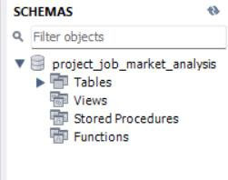

Get data from the database with the given credentials
Use the provided credentials to connect to the database and retrieve the dataset.
Found data by writing query- use project_job_market_analysis;

Slide 5
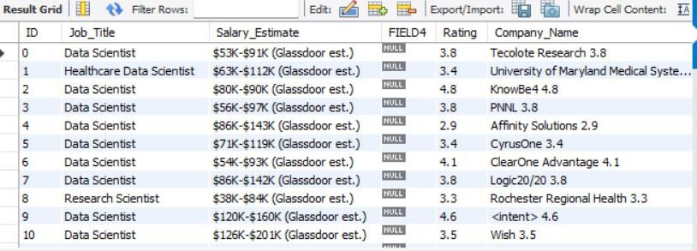
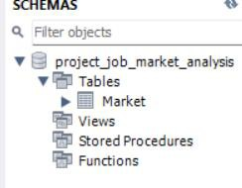
select * from Market;
Found created table ‘Market’ by using
Fetched whole dataset information which consists 43 columns and 743 rows and saved in folder. Opened in excel sheet
Attribute Information:
Job Title: The title of job, e.g. Data scientist, junior data scientist, senior data scientist etc.
Salary Estimate: Range of salary.
Job Description: Tells us what is expected out of the job title.
Rating: It gives the rating of the company
Company Name: Name of the company
Location: Location of the job
Headquarters: location of headquarter of the company

Slide 6
Size: Range of number of employee working in the company
Founded: Company founded in Year
Type of ownership: Tells us if the company is private, public or government owned.
Industry: Industry of the company
Sector: Sector in which company works
Revenue: Total revenue of the company per year
Competitors: Current competitor of the company in the same sector
Hourly: Tells us if the salary reported was hourly or yearly.
1: Hourly, 0: not hourly.
Employer provided: 1: If the salary was provided by the employee of the company, 0: otherwise.
Lower Salary: Lower salary reported for the job.
Uppr Salary: Upper salary reported for the job.
Avg Salary(K): Average of Lower and Upper salary yearly. K is the unit of the column, it means 1000. Also, the salary is in ($) U.S. dollars.
company_txt: It contains the name of the company.
Multiple skill columns (python, spark, aws, excel etc): 1: Skill is required by the company, 0: It is not required.
Jobtitle_sim: It contains the title of the job like Data scientist, ML engineer etc.
seniority_by_title: Seniority of the position, it is extracted from the Job Title.
Degree: If the job description mention that the company gives experience credit for a master(M) or Ph.D degree(P).

Slide 7
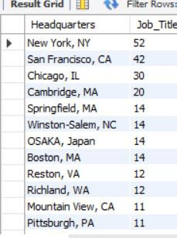
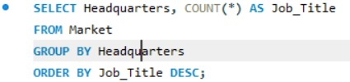
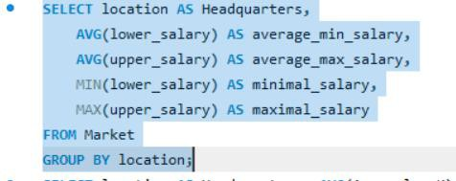
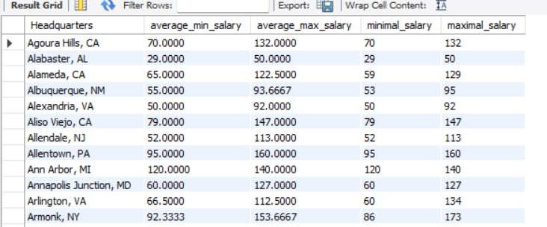
1.States with Most Number of Jobs
2. Average Minimal and Maximal Salaries in Different States

Slide 8
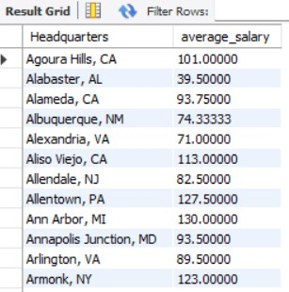

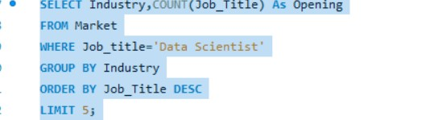
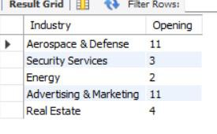
3. Average Salary in Different States
4. Top 5 Industries with Maximum Number of Data Science Related Job Postings

Slide 9
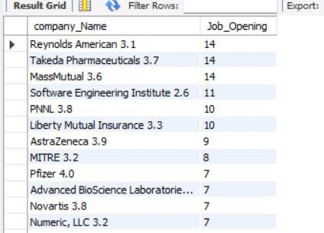
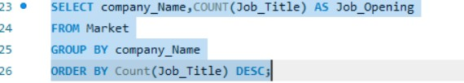
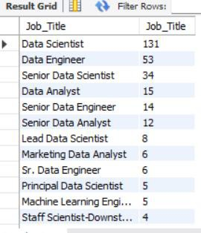
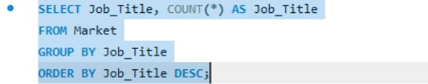
5. Companies with Maximum Number of Job Openings
6. Job Titles with Most Number of Jobs

Slide 10
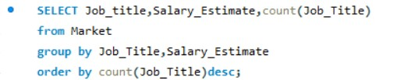
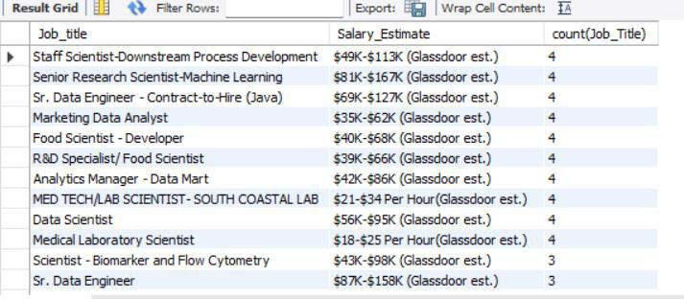
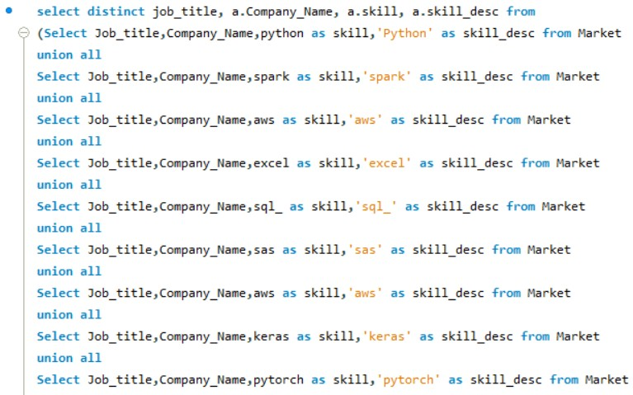
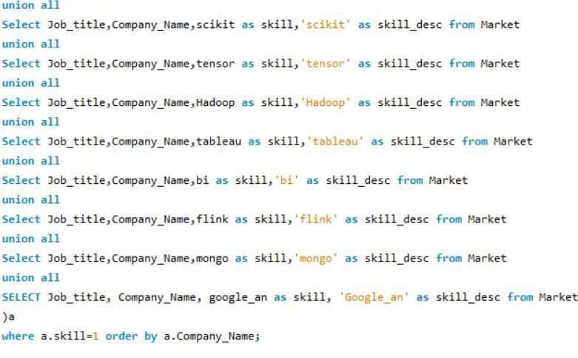
7. Salary of Job Titles with Most Number of Jobs
8. Skills Required by Companies for Each Job Title

Slide 11
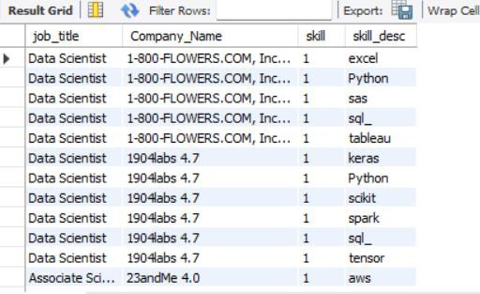
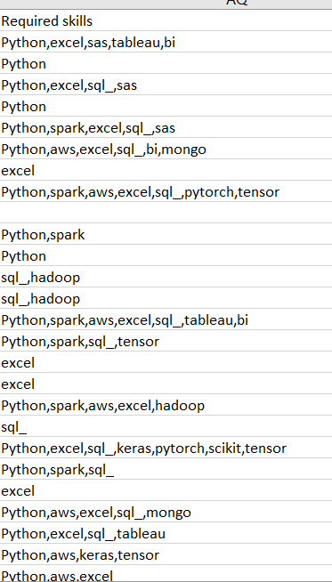
I found required all skills for each job title in excel sheet by using Text join formula.
TEXTJOIN(delimiter,Ingore_emptyspace,Text1…..)
Got output

Slide 12
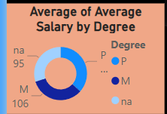
9.Relation between Average Salary and Education Examine the 'Degree' column and its relation to the average salary for different job titles. You might need to group the data by job title and degree to draw meaningful conclusions. 10.Visualize the data using Tableau/Power BI and give your inputs/suggestions. Import the cleaned and prepared dataset into Tableau or PowerBI. Create interactive visualizations to present the insights you've derived. Provide commentary on the visualizations and offer recommendations based on the data analysis.

Slide 13
Analyze all the features and derive multiple insights
Perform exploratory data analysis on various features to extract insights.
Look for correlations, trends, and patterns that can provide valuable information about the job market.
Multiple insights
Cards- Used to Calculate measurements like maximum, minimum, average salary, count of job openings and average age

Slide 14

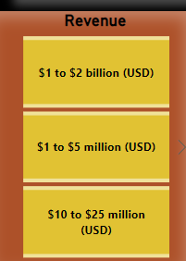
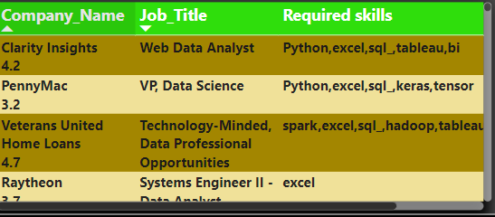
Slicers- Used to show category wise data
Table- Used to show required skills as per each company name and job title

Slide 15
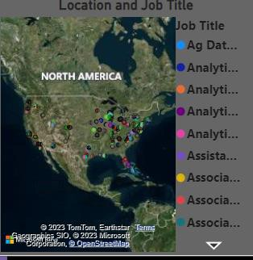
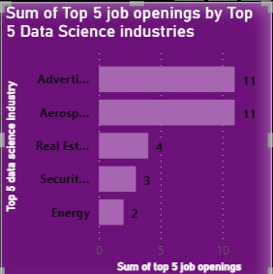
Map Chart-Used to represent job title as per location.
Bar Chart- It represents sum of top 5 job openings by top 5 data Science industries

Slide 16
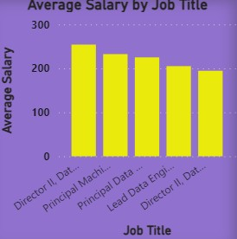
Column chart-Used to represent average salary of top 5 job title

Slide 17
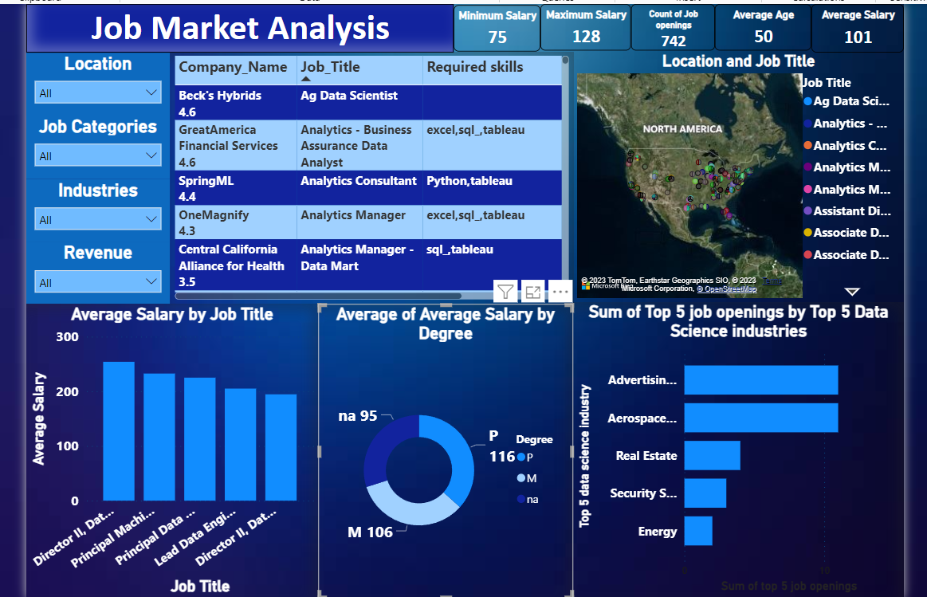
Dashboard is designed

Slide 18
suggestions to the company
As per our observation job market demands maximum number of Data Scientist with the total openings of 155 across the US and the Most Demanded skills are Python, Excel and SQL with the Estimated entry level salary : $56K - $95K and Sr Data Scientist estimated salary :$108K-$171K.in my point of view
Address and skill demand-Consider hiring candidates with strong proficiency in these skills to meet the demand efficiently.
Job titles insights-Recommend creating specialized roles within the Data Scientist category, such as Junior Data Scientist, to cater to varying experience levels.
Salary range consideration-Suggest periodic salary reviews to ensure compensation aligns with market standards and employee experience.
Data analytics tools-Recommend investing in resources and licenses for these tools to facilitate data analysis and reporting.
Continuous Learning and Development-Suggest implementing a culture of learning, including workshops, online courses, and certifications to keep employees updated with the latest trends.
Skills Development-Suggest conducting a skills gap analysis to determine if the company should invest in training or hiring for these specific skills.
Competitive analysis-Suggest studying competitors' hiring practices and offerings to ensure the company remains competitive.
Diversity and inclusion-Suggest considering diversity and inclusion efforts to attract a wide range of candidates.
Long term planning-Advise the company to create a long-term plan for addressing the growing demand for Data Scientists.

Slide 19
Thank you

